Slide 1
DWBI Final Project
Team 8
Arjun Upadhyay
Labdhi Shah
Vijayashree Uppili

Slide 2
Overview
Dimensional Model
SSIS Load
Talend Load
BI tools
Challenges
Learning outcomes

Slide 3
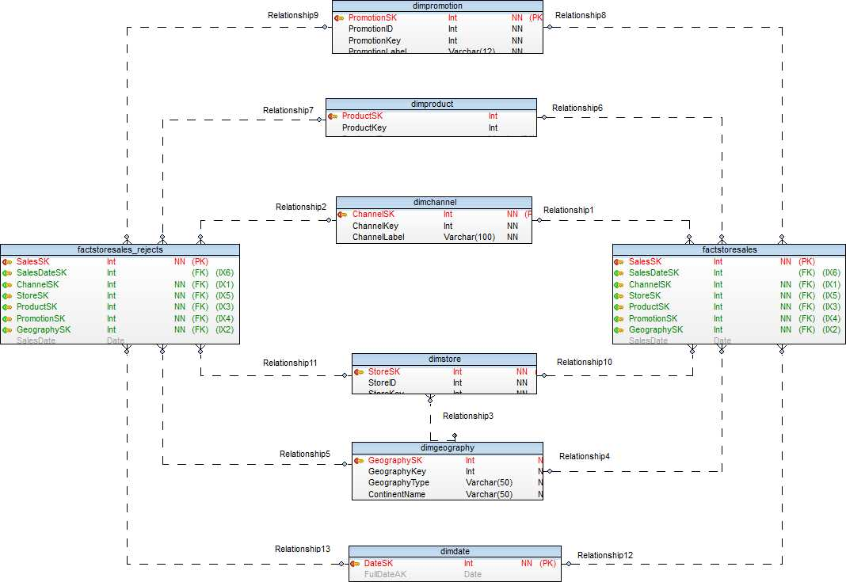
Dimensional Model(FactSales)

Slide 4
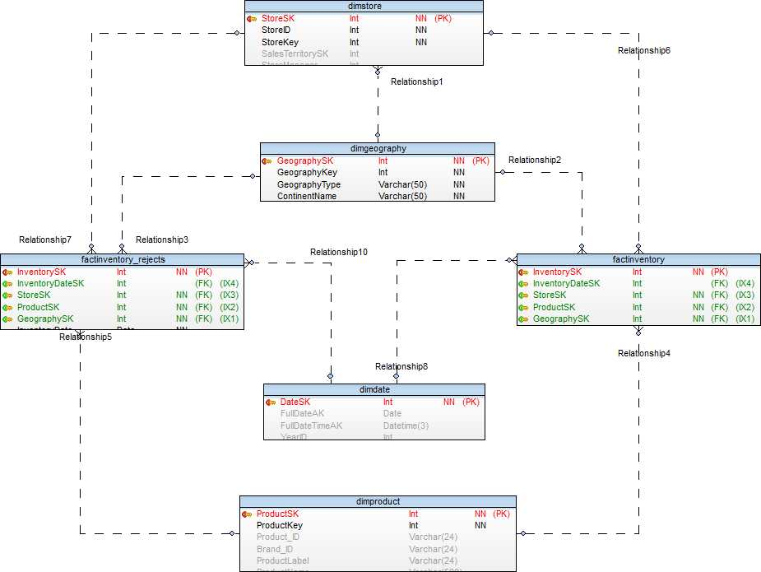
Dimensional Model (Inventory)

Slide 5
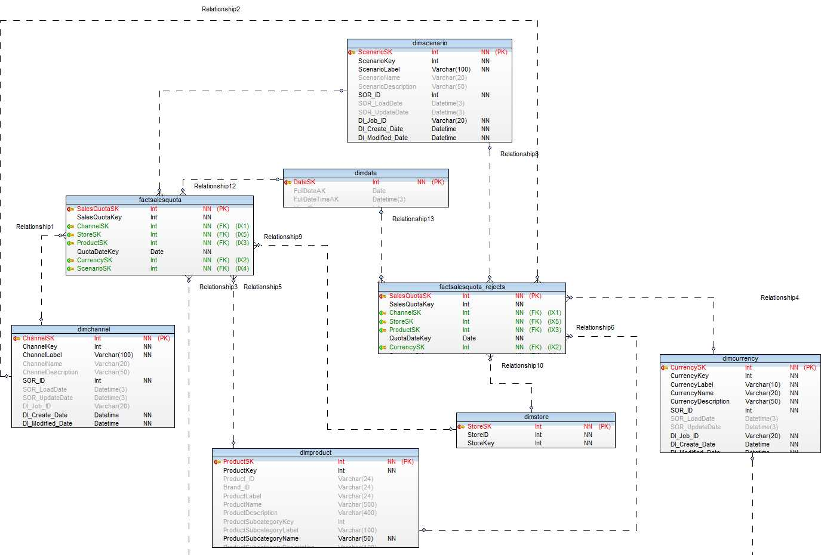
Dimensional Model(SalesQuota)

Slide 6
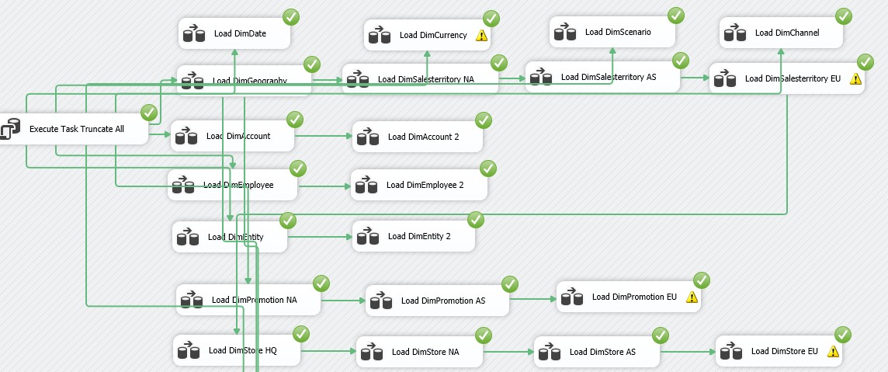
SSIS Load

Slide 7
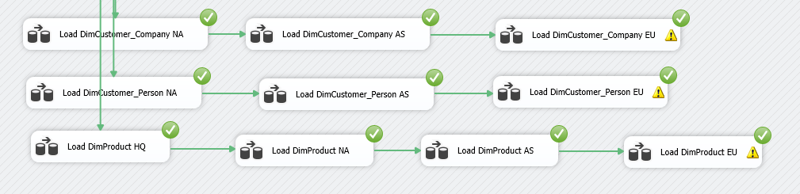
SSIS Load

Slide 8
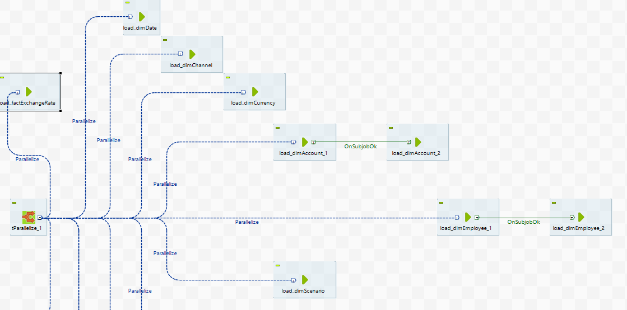
Talend Load

Slide 9
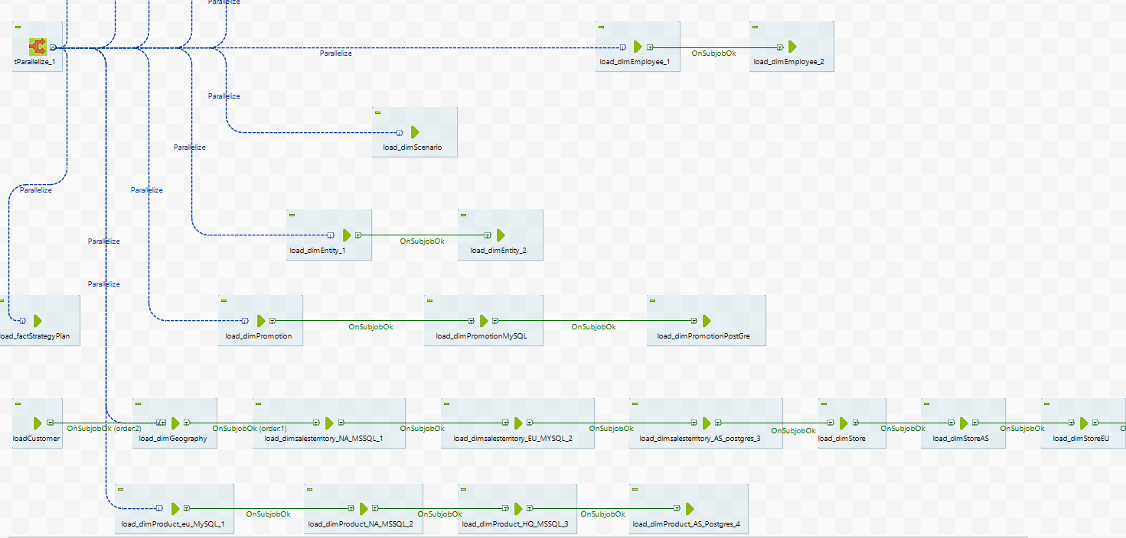
Cont.

Slide 10
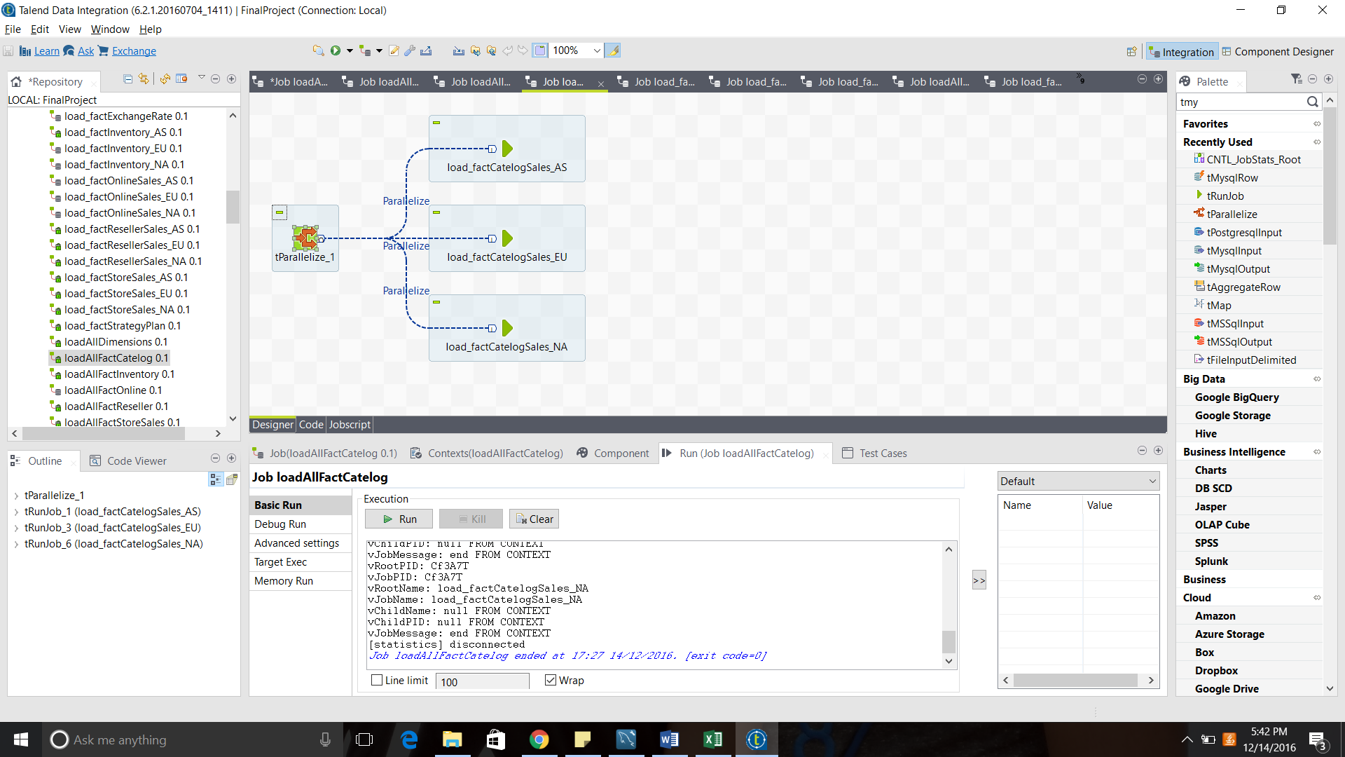
Load Fact Pattern in Talend

Slide 11
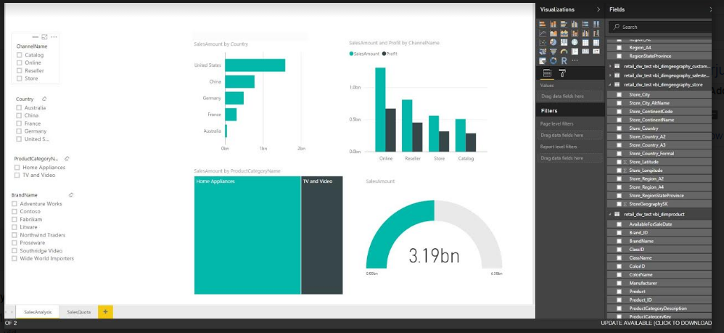
Power BI(MySQL)

Slide 12
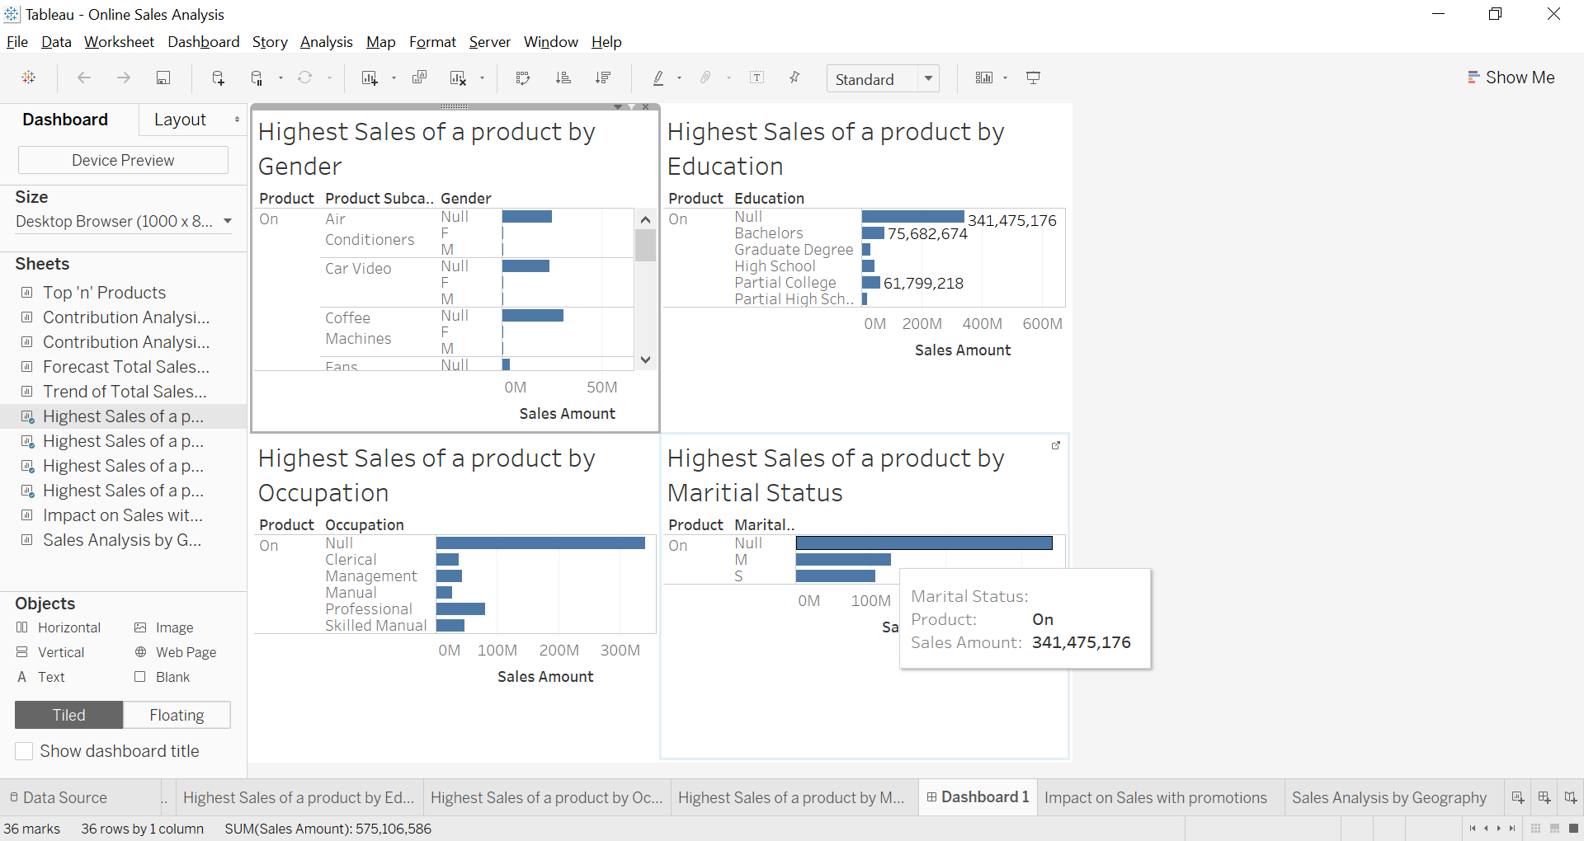
BI AnaLysis(Tableau-MSSQL)

Slide 13
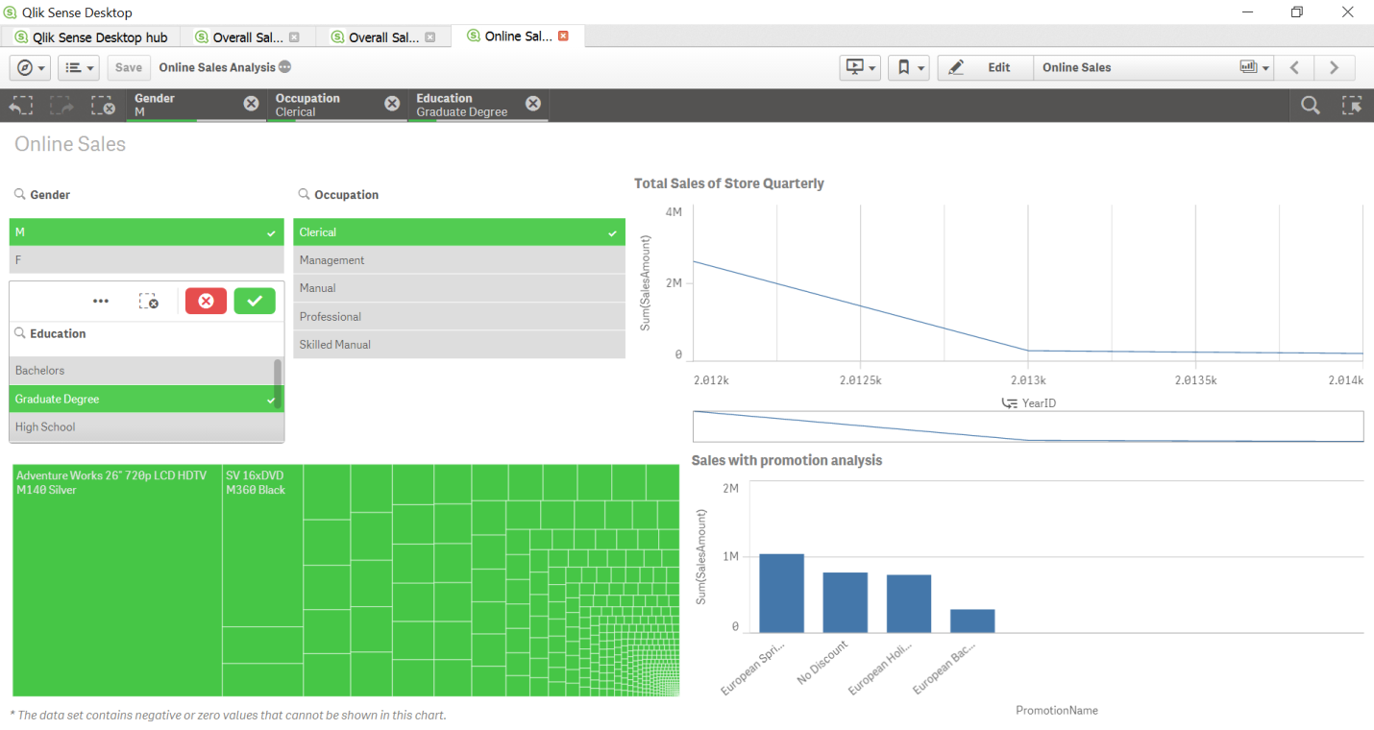
Qlik(MSSQL)

Slide 14
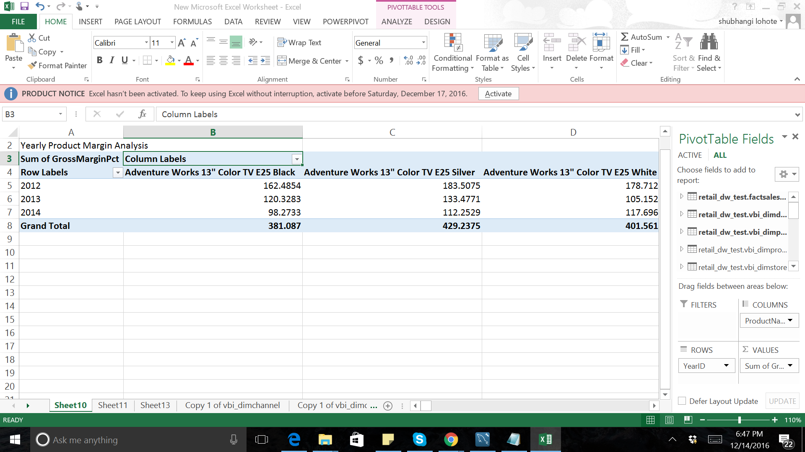
Power Pivot(MySql)

Slide 15
Differences
Forecast can be done in all BI tools
For pivot manual formula which uses linear regression algorithms
For Tableau simple drag and drop forecast option
For Qlik has a complicated ways of doing forecast by manipulating the axis
PowerBI can do trend analysis and for forecasting need calculation(need to research on this)

Slide 16
Trend Analysis
Tableau provides recommendation for specific analysis
Need to select visualization manually in Qlik and power BI
Power pivot limited visualization available best comparisons can be done using line charts and trend line can be implemented

Slide 17
Rank Functions
Tableau provides easy implementation of Top n filter
Need to write DAX function for Power BI
Filters easy to implement in Power pivot less interactive
Segregation of group and calculating top n when grouping on different granularity are supported well in tableau and Qlik

Slide 18
Hierarchy creation
Easy in Tableau and Qlik. Tableau creates hierarchy without creating copy of attributes
Create columns in Power BI in the data
Power Pivot creates synthetic keys while relating columns which need to be altered before proceeding with the relation between data.

Slide 19
Challenges
Finding relation between tables
Difficulty in understanding the business terms as no documentation available
Loading data for facts (with inner join no rejects)
Less time to analyze data and load
SSIS driver dependency for postgre and mysql

Slide 20
Learning Outcomes
Understanding the difference between SSIS and Talend.
Hands on various BI tools and learning the difference in implementing various analysis
SCD implementation
The power of DI tools in integrating data from different schemas

